Slide 1

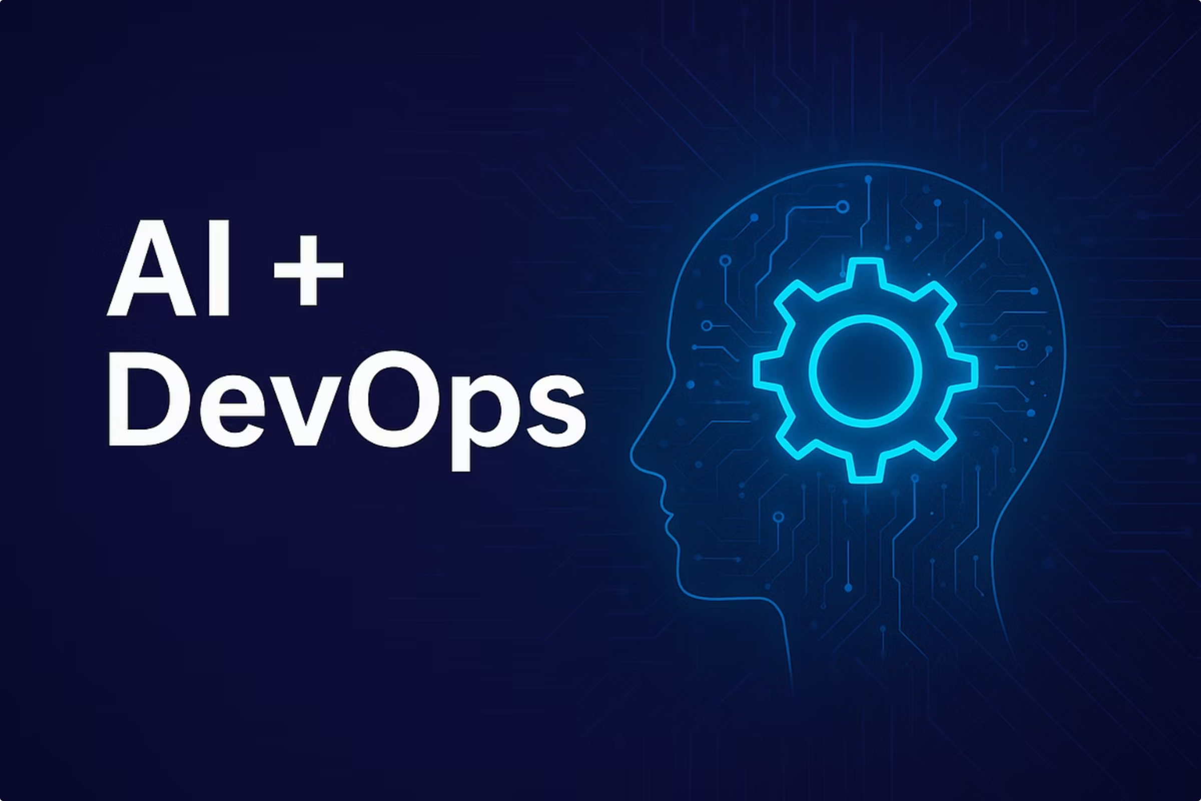
AiDevopsMonitoringAgent
AI-Powered Real-Time Infrastructure Monitoring and Incident Analysis
Ashutosh Thakur | February 2026

Slide 2
The Monitoring Challenge
Modern infrastructure demands real-time visibility, but traditional monitoring approaches create bottlenecks that impact reliability and increase operational overhead.
Manual Monitoring Bottlenecks
Alert Fatigue Crisis
Expertise-Dependent RCA
Silos of monitoring tools generate thousands of alerts daily. Teams become desensitized, causing genuine incidents to be overlooked.
Root cause analysis requires deep domain knowledge spanning multiple system layers, creating dependency on senior engineers.
Engineering teams spend hours parsing dashboards and logs across distributed systems, leading to delayed detection of critical issues.
Disconnected Tooling
Cost of Downtime
Traditional monitoring lacks intelligent correlation between metrics, logs, and traces—forcing engineers to manually connect the dots.
Every minute of service disruption impacts revenue, user trust, and operational stability—making rapid response non-negotiable.

Slide 3

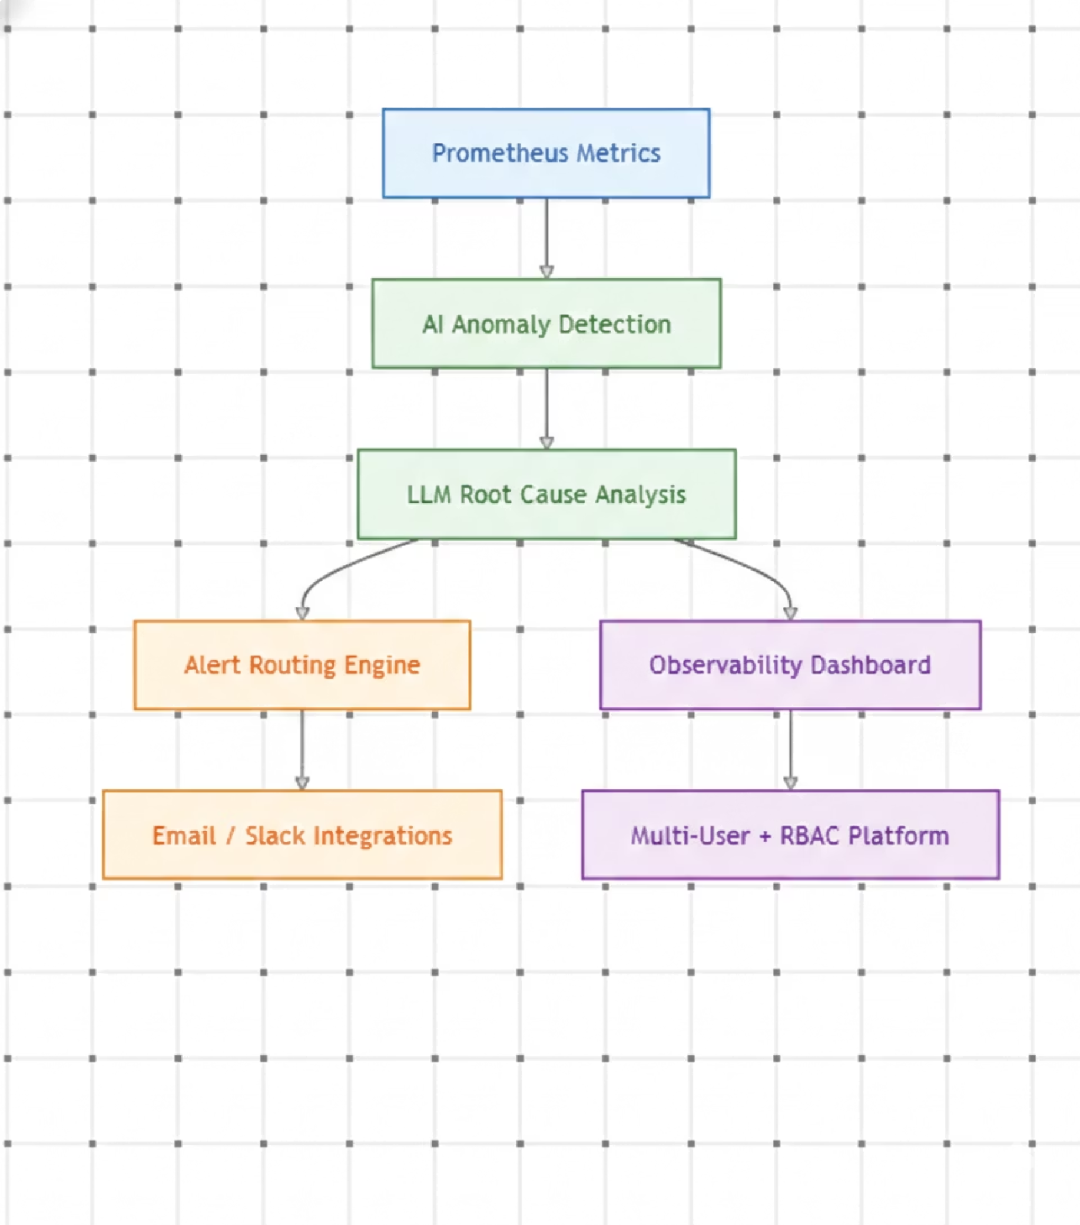





An Intelligent, Automated Solution
AiDevopsMonitoringAgent bridges cutting-edge AI capabilities with DevOps monitoring principles, transforming reactive alerting into proactive observability.
AI-Driven Anomaly Detection
Continuous metric ingestion from Prometheus targets combined with intelligent pattern recognition identifies subtle anomalies before they escalate.
LLM-Powered Root Cause Analysis
Generates human-readable incident summaries and causal chains using Gemini's contextual understanding of your infrastructure.
Self-Service Platform
Multi-user architecture with role-based isolation enables teams to configure monitoring independently while maintaining data boundaries.
Intelligent Alert Routing
Automatically dispatches contextual alerts via Email and Slack integrations when thresholds breach, with severity-based escalation paths.

Slide 4
System Architecture Overview
A distributed, cloud-native architecture integrates battle-tested monitoring tools with modern AI/ML pipelines while maintaining operational observability.
01
02
React Frontend Interface
FastAPI Backend Engine
User dashboard built with React communicates with backend via REST APIs, providing real-time updates and configuration management.
Python-based API layer handles authentication, request routing, and orchestrates the monitoring pipeline with async processing.
03
04
Prometheus Scraping Layer
Gemini LLM Analysis
Dynamic target discovery fetches metrics at configurable intervals, supporting file-based service discovery for containerized workloads.
Batched metrics fed to Gemini 2.5 Pro for anomaly classification, severity scoring, and automated root cause generation.
05
06
MongoDB Data Storage
Langfuse Observability
Structured document storage segregates incidents, anomalies, and RCA data by user for compliance and isolation requirements.
Tracks LLM token usage, response latency, and costs—ensuring transparent AI operations and budget optimization.

Slide 5
Technology Stack
Enterprise-grade components selected for performance, maintainability, and production readiness in high-availability environments.
Backend Infrastructure
Frontend Stack
Python 3.11 with type annotations for robust error handling
FastAPI framework providing OpenAPI documentation and validation
Uvicorn ASGI server for high-concurrency request handling
Prometheus Client libraries for metric instrumentation
Pydantic for data validation and settings management
React 18 with hooks for component state management
Vite as modern build tool with hot module replacement
Tailwind CSS for utility-first responsive styling
TypeScript providing compile-time type safety
Recharts for interactive time-series visualizations
AI/ML Engine
Data & Monitoring
Gemini 2.5 Pro for primary analysis with 1M+ token context
Gemma 3 as fallback model for cost-sensitive queries
LangChain for prompt templating and chain orchestration
Langfuse for LLM tracing and cost attribution
MongoDB Atlas for managed document storage
Prometheus for time-series metric collection
Custom Exporters for proprietary system metrics
JSON logging for structured analysis pipelines

Slide 6
Core Features and Workflow
An automated pipeline that transforms raw metrics into actionable intelligence—reducing incident response time from hours to minutes.
Dynamic Target Registration
1
Users add Prometheus scrape targets through the React dashboard. Configuration stored in MongoDB with validation rules preventing malformed inputs.
2
Continuous Metric Collection
Prometheus discovers targets via file-based service discovery, scraping endpoints at 15-second intervals by default. Metrics batched by user identity for analysis.
AI-Powered Anomaly Classification
3
Gemini analyzes metric patterns, comparing against historical baselines. Assigns severity scores from Critical to Warning based on impact potential.
4
Automated Root Cause Generation
For every detected anomaly, LLM analyzes correlated metrics, logs, and system topology. Produces plain-English causal chains with supporting evidence.
Multi-Channel Alert Dispatch
5
When thresholds breach, system triggers immediate notifications. Email provides detailed RCA while Slack sends summary to on-call channels.
6
AI Chat Assistant
Users query infrastructure state using natural language. Agent translates questions to PromQL, fetches metrics, and explains trends conversationally.

Slide 7
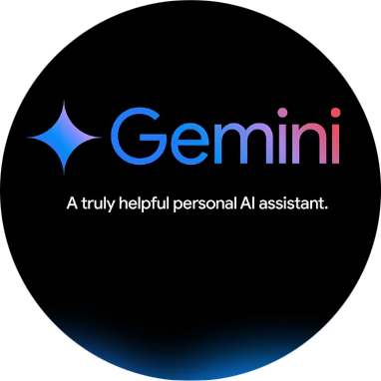
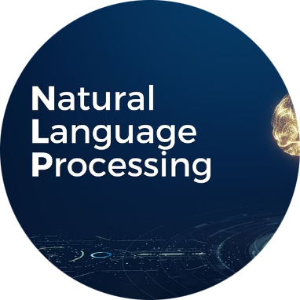
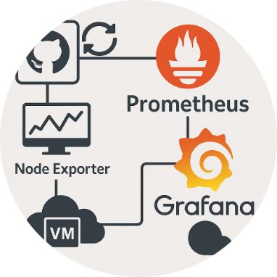

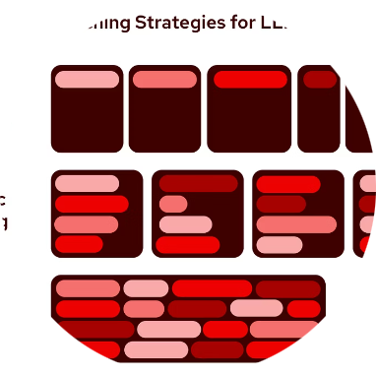
AI and DevOps Integration
Leverages Google's Gemini 2.5 Pro for production-grade AI analysis, combining speed, accuracy, and cost-efficiency for real-world monitoring workloads.
LLM Selection Strategy
Natural Language Output
PromQL Integration
Dynamic Service Discovery
Gemini 2.5 Pro provides optimal balance: 128K context window handles complex queries, multimodal support future-proofed, and predictable pricing per 1M tokens.
Generates incident descriptions in plain English, translating technical metrics into business-impact statements accessible to all stakeholders—not just SREs.
Direct Prometheus query execution through Gemini's code interpreter. Translates user questions into efficient PromQL, avoiding manual query writing.
File-based SD automatically identifies scrape targets as infrastructure changes. JSON configuration reloads without restart—enabling GitOps workflows.
Configurable Batching
Adjust metric collection intervals from 5 seconds to 60 seconds based on workload volatility. Longer intervals reduce costs; shorter windows enable faster detection.

Slide 8



Security, Scalability, and Reliability
Enterprise-grade security controls and horizontal scaling architecture ensure the system remains available and secure as infrastructure grows.
Authentication & Access Control
Data Isolation & Tenancy
JWT Authentication with refresh token rotation every 7 days prevents session hijacking
Argon2 Password Hashing provides memory-hard security against GPU cracking
API Rate Limiting using sliding window counters to prevent abuse and DDoS attacks
Role-Based Access Control enforces read-only vs. admin permissions across users
Per-User Segregation ensures queries cannot access other users' incidents or configurations
Database-Level Enforcement adds WHERE clauses automatically—preventing accidental leaks
Encrypted at Rest using MongoDB Atlas transparent data encryption with customer-managed keys
Field-Level Encryption for sensitive credentials in target configurations
Stateless Backend
Auto-Scaling Storage
Async Processing
FastAPI instances process requests independently, allowing horizontal scaling via Kubernetes replicas as traffic increases.
MongoDB Atlas automatically provisions additional shards based on metric volume—no manual intervention needed.
Non-blocking metric analysis ensures frontend stays responsive even during anomaly storms.

Slide 9
Challenges and Future Enhancements
Continuous innovation roadmap addresses current technical constraints while expanding platform capabilities for next-generation infrastructure.
Current Limitations
Planned Features
LLM Latency Impact
Predictive Alerting
Gemini API response times (200-500ms) add delay to real-time detection. Mitigated via batch processing but may miss sub-second anomalies.
Historical trend analysis using time-series forecasting to predict threshold breaches before they occur—shifting from reactive to proactive.
Token Constraints
Metric Filtering
Context window limits metrics volume per analysis batch. Large clusters require strategic metric selection to stay within budget.
Enable advanced metric filtering by service, environment, severity, or time range to reduce noise and improve analysis precision.

Slide 10




Transform Your Monitoring Strategy
AiDevopsMonitoringAgent represents the convergence of AI and DevOps—delivering production-ready monitoring that reduces mean time to resolution and enables proactive infrastructure management.
AI + DevOps Fusion
Faster Incident Response
Bridges intelligent analysis with operational expertise, enabling teams to focus on strategic improvements rather than alert chasing.
Automated root cause generation cuts diagnosis time from hours to seconds—minimizing downtime impact on business operations.
Multi-User Ready
Proactive Observability
Production-hardened architecture supports enterprise-scale teams with data isolation, role-based access, and horizontal scaling to hundreds of users.
Moves beyond reactive alerting to predictive insights and auto-remediation—transforming monitoring from cost center to competitive advantage.
"The future of infrastructure monitoring isn't about generating more alerts—it's about generating better understanding. AiDevopsMonitoringAgent delivers just that."

